Slide 1
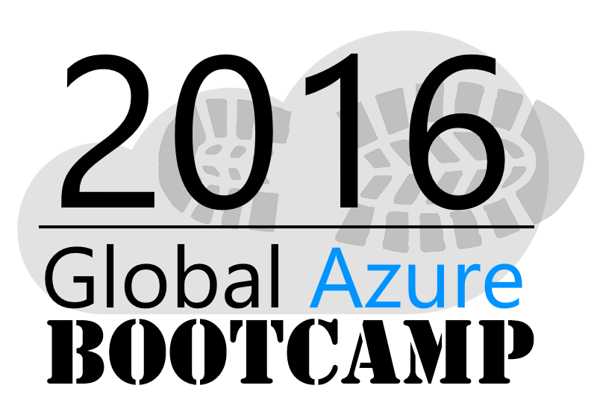
Welcome to the
Copenhagen

Slide 2
Azure IaaS
Jesper Jensen
Twitter: @jefutte / Email: jj@solvoit.com

Slide 3
Agenda
Virtual Machines
Virtual Networks
Storage
Azure Resource Manager
Azure Backup

Slide 4
Virtual Machines

Slide 5


Provisioning VM
Getting Started
Select Image and VM Size
New Disk Persisted in Storage
Windows Server
Management Portal
Boot VM from New Disk
Linux
>_
General Purpose
Basic
Standard
Optimized Compute
Performance Optimized
Network Optimized
Scripting
(Windows, Linux and Mac)
Cloud
REST API
Notes:
Slide Objective:
Explain workflow for provisioning VMs in the cloud
Speaker Notes:
You have three methods of starting this process: Build a VM from the portal, from the command line OR programmatically calling the REST API.
Once your choice of provisioning is made you will need to select the image and instance size to start from.
The newly created disk will be stored in blob storage and your machine will boot.

Slide 6
Demo: Managing VMs using Azure portal
Notes:
Demo: Provisioning VM
Prerequisites:
A Windows Server 2012 is already provisioned.
Steps:
Open Ibiza portal and click the NEW button at the lower-left corner.
Show the short list of resources. Explain that I can directly create popular resources here such as a Windows Server 2012.
Click on the Everything link.
In Gallery blade, open the Virtual machines category.
Scroll down the view and show images of different types (refer back to slide 9).
Click on Windows Server 2012 R2, and then click the Create button in the overview blade. For non-Microsoft focused audience, consider to pick a Linux image instead.
Fill in the Create VM form and click on the Create button to provision the VM. Explain this will take a few minutes.
Open the already provisioned VM.
Scroll down the blade to show various of information available on the blade.
Click on the Extensions tile.
On the Extensions blade, click on the ADD icon to bring up the extension list. Introduce that VM extensions are installable components to customize VM instances.
Switch to slides to continue with VM extension introduction.

Slide 7
Data Persistence
OS Disks
Data Disks

Slide 8
Disks and Images
OS Images
Microsoft
Partner
User
Base OS image for new Virtual Machines
Sys-Prepped/Generalized/Read Only
Created by uploading or by capture
Disks
OS Disks
Data Disks
Writable Disks for Virtual Machines
Created during VM creation or during upload of existing VHDs.
Notes:
Slide Objective:
Explain the differences between disks and images with VMs

Slide 9
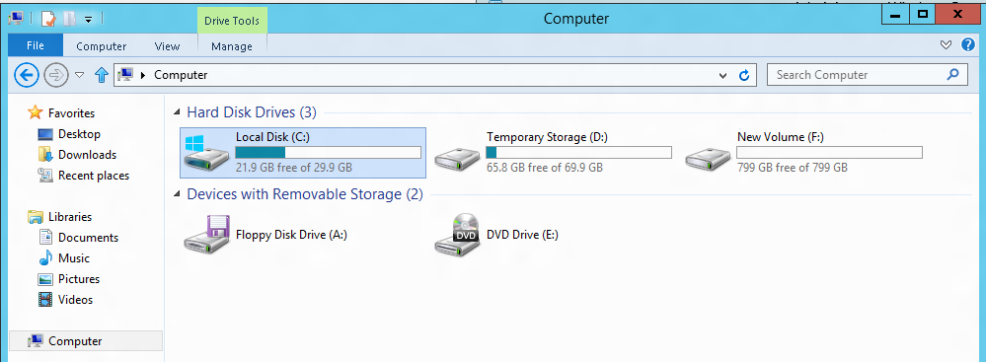
VM disk layout
OS Disk
Persistent
SATA
Drive C:
Temporary Storage Disk
Local (Not Persistent)
SATA
Drive D:
Data Disk(s)
Persistent
SCSI
Customer Defined Letter

Slide 10
Temporary Drive Guidance
Never Place Critical Unreplicated Data on Temp Drive!!
Use for SQL TempDB and Buffer Pool Extension on D-Series and G-Series VM Sizes Only (SSD Temp Disks)
Detailed instructions: http://blogs.technet.com/b/dataplatforminsider/archive/2014/09/25/using-ssds-in-azure-vms-to-store-sql-server-tempdb-and-buffer-pool-extensions.aspx
Use Scheduled Tasks to Configure Temporary Disk
Test Scheduled Tasks via Resize VM Operation

Slide 11

Service Level Agreements
99.95% for multiple role instances
4.38 hours of downtime per year
What’s included
Compute Hardware failure (disk, CPU, memory)
Datacenter failures - Network failure, power failure
Hardware upgrades, Software maintenance – Host OS Updates
What is not included
VM Container crashes, Guest OS Updates

Slide 12

Availability Sets
Availability set
SLA High Availability
Hardware and Software
Windows and Linux
Virtual Machine
Virtual Machine
SQL Server
Primary
SQL Server
Secondary
SLA 99.95

Slide 13
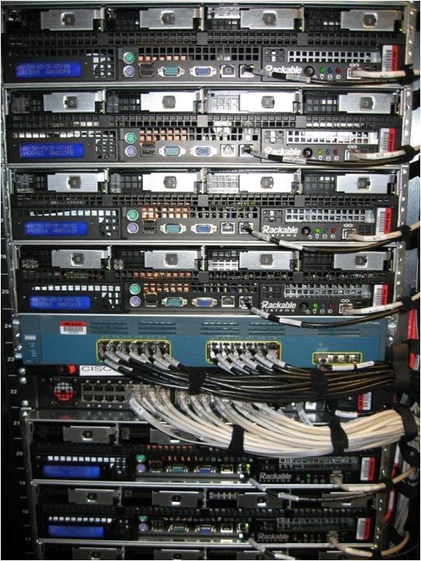
Availability Sets
Physical Machines
Power Unit
Rack Switch

Slide 14

Availability Sets
Physical Machines
Power Unit
Rack Switch
VM1
VM2
VM2
VM1
VM2
Availability Set

Slide 15
Availability Set Guidance
VMs in Availability Set Must Be in Same Resource Group
Availability Set: 20 Update Domains, 3 Fault Domains
Update Domain – Host Maintenance
Fault Domain – Isolation from component failure in rack unit
Maximum of 100 VMs in a Availability Set
Avoid Availability Sets with Single VM
This eliminates notification for host maintenance operations
https://azure.microsoft.com/en-us/documentation/articles/azure-subscription-service-limits/

Slide 16
Load balancing
Load balancing
Multiple VMs share the workload via public facing endpoints
Internal Load balancing
Load balancing between VMs that don’t have public facing endpoints
Microsoft Azure
Internet
Public VIP
Customer vNet
External Load Balancer
Internal Load Balancer
Microsoft Azure
Back end
Front end

Slide 17
Traffic Manager
Load balancing
Failover
US West
North Europe
Microsoft Azure
North America
Europe

Slide 18
Virtual Networks

Slide 19
Azure Virtual Networks
A protected private virtual network in cloud
Extend enterprise networks into Azure
Cross-premises connectivity

Slide 20






Cross-premises Connectivity
Site-to-site
Create a secure connection between your on-premises site and your virtual network
Point-to-site
Create a secure connection via VPN to your virtual network
ExpressRouteTM
Create a private connection between Azure data centers and infrastructures on your premises or in a co-location environment.
Connect at an ExpressRoute location (Exchange Provider facility)
Direct connect via a Network Service Provider
Microsoft Azure

Slide 21
Demo: Virtual Network & Site-to-Site VPN
Notes:
Demo: Point-to-Site connection
Prerequisites:
Follow step 1-15 below to prepare the environment.
(http://haishibai.blogspot.com/2013/05/walkthrough-file-sharing-between-your.html)
Steps:
Run through steps 17-21 in the following steps. If time permits, you can start with step 16.
Log on to (current) Microsoft Azure Management Portal.
On command bar, click on NEW button, then select NETWORKS->VIRTUAL NETWORK->CUSTOM CREATE menu.
On Virtual Network Details page, enter network NAME as pointtosite, create or select a AFFINITY GROUP, then click next arrow.
On DNS Servers and VPN Connectivity page, check Configure Point-to-Site VPN, then click next arrow:
On Point-to-Site Connectivity page, click next arrow.
On Virtual Network Address Spaces page, click on add gateway subnet button, and then click on check icon to complete network creation.
After the virtual network has been created, open its DASHBOARD page, and the click CREATE GATEWAY icon to create the dynamic routing gateway.
Add a new Windows Server 2012 virtual machine to the virtual network. Note that when you specify user credential, make sure to use the same user id and password of your local account. This is because the virtual machine on Microsoft Azure is not under your domain controller, and we are using the same user credential on both local and virtual machines to allow file sharing.
As the virtual machine is cooking, let’s create two self-signed certificates: one for root, and another for client identification. During the following steps we’ll need to upload the root certificate to Microsoft Azure so Microsoft Azure can validate the client machine using the certificate chain.
Launch Developer Command Prompt for VS2012 as administrator. Change current folder to a folder where you want to keep the generated certificates. Here I’ll use folder c:\books.
Use command makecert -sky exchange -r -n "CN=MyFakeRoot" -pe -a sha1 -len 2048 -ss My to create root certificate.
Use command makecert -n "CN=MyLaptop" -pe -sky exchange -m 96 -ss My -in "MyFakeRoot" -is my -a sha1 to create client certificate.
Launch certmgr. Export the root certificate as a MyFakeRoot.cer file (without private key).
[Optional] if you are configuring VPN for another client, you’d need to install the client certificate on target machine.
Go back to Microsoft Azure Management Portal. On DASHBOARD page of the virtual network, click on link Upload client certificate to upload the root certificate. Note at this point the gateway should have been created.
After certificate has been uploaded, you can download and install VPN client from the DASHBOARD page (AMD64 Client link for 64-bit machines, x86 Client link for 32-bit machines).
After VPN client has been installed, you can see the VPN connection on your Windows network connection list. Click on the network to connect. When prompted by the VPN client, click Connect button to continue.
[Optional] Now you can use ipconfig/all to verify if VPN connection has been successfully established (look for PPP adapter).
Log on to the virtual machine, create a new Share folder under c:\. Share the folder with the user you specified when you created the virtual machine.
On Management Portal, record the virtual machines private IP on its DASHBOARD page. In my case the IP is 10.0.1.4.
Now you can use Explorer on your local machine and access the shared folder by \\10.0.1.4\Share.

Slide 22
Storage

Slide 23
Storage
Storage accounts have many variables
Establish a Storage “Stamp” model
Determine initial storage account footprint based on workload requirements
Determine process and policy where a new stamp would be created or extended
Typical “stamp” would include these storage accounts:
LRS
GRS
Premium Storage
Notes:
Understand that the design goal of storage for most enterprise organizations should be to develop a “virtual SAN” in the cloud that has rules around how (and what) to provision and when to expand.

Slide 24
Demo: Storage Accounts
Notes:
Demo: Point-to-Site connection
Prerequisites:
Follow step 1-15 below to prepare the environment.
(http://haishibai.blogspot.com/2013/05/walkthrough-file-sharing-between-your.html)
Steps:
Run through steps 17-21 in the following steps. If time permits, you can start with step 16.
Log on to (current) Microsoft Azure Management Portal.
On command bar, click on NEW button, then select NETWORKS->VIRTUAL NETWORK->CUSTOM CREATE menu.
On Virtual Network Details page, enter network NAME as pointtosite, create or select a AFFINITY GROUP, then click next arrow.
On DNS Servers and VPN Connectivity page, check Configure Point-to-Site VPN, then click next arrow:
On Point-to-Site Connectivity page, click next arrow.
On Virtual Network Address Spaces page, click on add gateway subnet button, and then click on check icon to complete network creation.
After the virtual network has been created, open its DASHBOARD page, and the click CREATE GATEWAY icon to create the dynamic routing gateway.
Add a new Windows Server 2012 virtual machine to the virtual network. Note that when you specify user credential, make sure to use the same user id and password of your local account. This is because the virtual machine on Microsoft Azure is not under your domain controller, and we are using the same user credential on both local and virtual machines to allow file sharing.
As the virtual machine is cooking, let’s create two self-signed certificates: one for root, and another for client identification. During the following steps we’ll need to upload the root certificate to Microsoft Azure so Microsoft Azure can validate the client machine using the certificate chain.
Launch Developer Command Prompt for VS2012 as administrator. Change current folder to a folder where you want to keep the generated certificates. Here I’ll use folder c:\books.
Use command makecert -sky exchange -r -n "CN=MyFakeRoot" -pe -a sha1 -len 2048 -ss My to create root certificate.
Use command makecert -n "CN=MyLaptop" -pe -sky exchange -m 96 -ss My -in "MyFakeRoot" -is my -a sha1 to create client certificate.
Launch certmgr. Export the root certificate as a MyFakeRoot.cer file (without private key).
[Optional] if you are configuring VPN for another client, you’d need to install the client certificate on target machine.
Go back to Microsoft Azure Management Portal. On DASHBOARD page of the virtual network, click on link Upload client certificate to upload the root certificate. Note at this point the gateway should have been created.
After certificate has been uploaded, you can download and install VPN client from the DASHBOARD page (AMD64 Client link for 64-bit machines, x86 Client link for 32-bit machines).
After VPN client has been installed, you can see the VPN connection on your Windows network connection list. Click on the network to connect. When prompted by the VPN client, click Connect button to continue.
[Optional] Now you can use ipconfig/all to verify if VPN connection has been successfully established (look for PPP adapter).
Log on to the virtual machine, create a new Share folder under c:\. Share the folder with the user you specified when you created the virtual machine.
On Management Portal, record the virtual machines private IP on its DASHBOARD page. In my case the IP is 10.0.1.4.
Now you can use Explorer on your local machine and access the shared folder by \\10.0.1.4\Share.

Slide 25
Azure Resource Manager

Slide 26
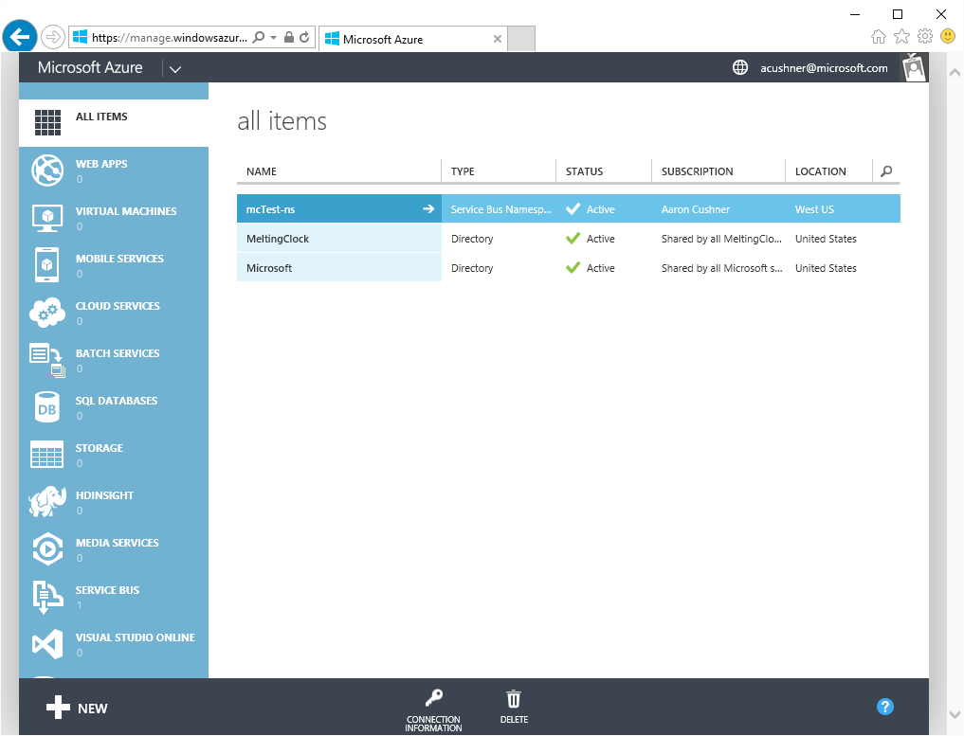
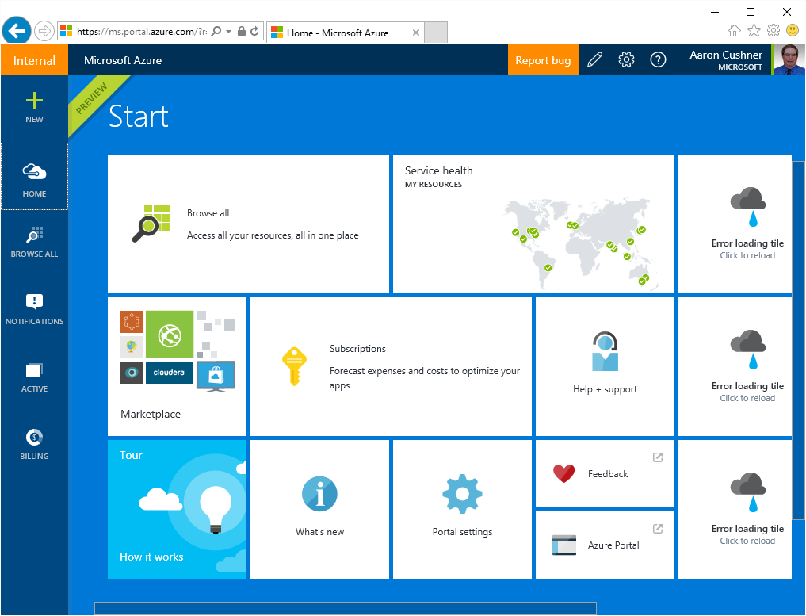
Azure Portals and Frameworks
Classic: manage.windowsazure.com
New: portal.azure.com
Azure Service Management (ASM)
No Role Based Access Control
Azure Resource Manager (ARM)
Role Based Access Contro

Slide 27
Resource Groups
Manage resources as a single unit
Role based access and control (RBAC) on groups or resources
Billing integrated tagging on groups or resources
RESOURCE GROUP
container for multiple resources
IaaS + PaaS resources
resources exist in one resource group
resource groups can span regions
resource groups can span services

Slide 28



Azure Resource Manager (ARM)
This slide could use build/animation. It builds from top to bottom. Azure/Commandline/Visual studio all hit the API to interact with resource manager groups which in turn interact with the different rest points. The link https://azure.microsoft.com/en-us/documentation/articles/virtual-machines-azure-resource-manager-architecture/
explains what this slide is supposed to get across.
RESOURCE MANAGER
Consistent management layer
Tools
SERVICE MANAGEMENT API
Microsoft Azure
Command line
Visual Studio
ADFS
AAD
Contoso
Curated extensions
Cloud
On-premises
RESOURCE PROVIDER CONRACT
Provider rest points
DB

Slide 29
Azure Resource Manager templates
ARM templates can:
Simplify deployment
Simplify roll-back
Provide cross-resource configuration and update support
Be used as a learning tool to build to suit
Azure templates are:
Source file, checked-in
Specifies resources and dependencies (VMs, websites, DBs) and connections (configuration, LB sets)
Configurable parameters for input/output
ARM template
SQL-A website
Repeatable configuration
Configuration→ Resource Group
[SQL CONFIG] VM (2x)
Depends on SQL
Depends on SQL
DEPENDS ON SQL
SQL-A
Website
Virtual Machines
DB
SQL configuration

Slide 30
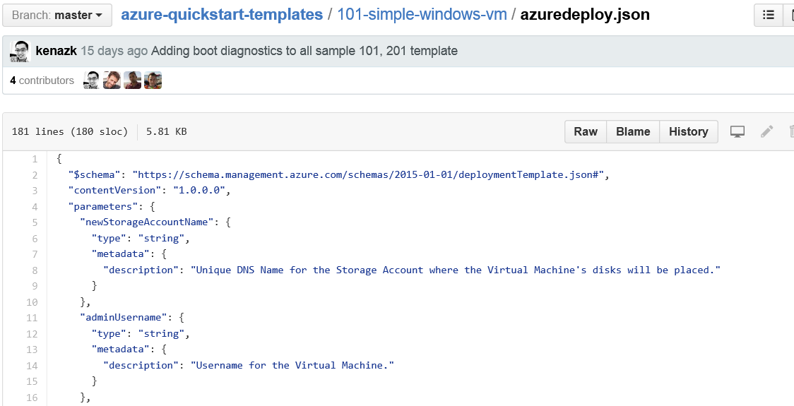
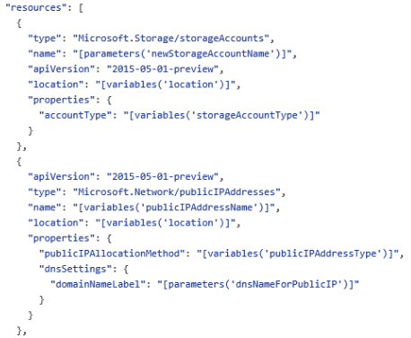
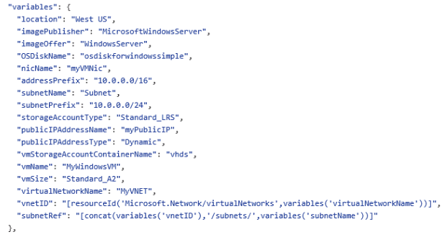
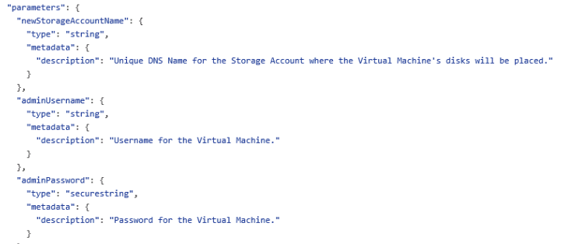
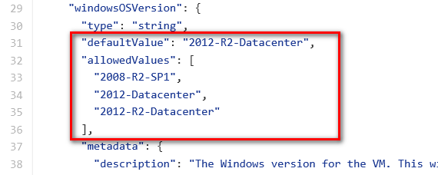
JSON files—simpler than they look Schema, content version, parameters, variables, resources, and outputs

Slide 31
Demo: Templates in Visual Studio
Notes:
Demo: Point-to-Site connection
Prerequisites:
Follow step 1-15 below to prepare the environment.
(http://haishibai.blogspot.com/2013/05/walkthrough-file-sharing-between-your.html)
Steps:
Run through steps 17-21 in the following steps. If time permits, you can start with step 16.
Log on to (current) Microsoft Azure Management Portal.
On command bar, click on NEW button, then select NETWORKS->VIRTUAL NETWORK->CUSTOM CREATE menu.
On Virtual Network Details page, enter network NAME as pointtosite, create or select a AFFINITY GROUP, then click next arrow.
On DNS Servers and VPN Connectivity page, check Configure Point-to-Site VPN, then click next arrow:
On Point-to-Site Connectivity page, click next arrow.
On Virtual Network Address Spaces page, click on add gateway subnet button, and then click on check icon to complete network creation.
After the virtual network has been created, open its DASHBOARD page, and the click CREATE GATEWAY icon to create the dynamic routing gateway.
Add a new Windows Server 2012 virtual machine to the virtual network. Note that when you specify user credential, make sure to use the same user id and password of your local account. This is because the virtual machine on Microsoft Azure is not under your domain controller, and we are using the same user credential on both local and virtual machines to allow file sharing.
As the virtual machine is cooking, let’s create two self-signed certificates: one for root, and another for client identification. During the following steps we’ll need to upload the root certificate to Microsoft Azure so Microsoft Azure can validate the client machine using the certificate chain.
Launch Developer Command Prompt for VS2012 as administrator. Change current folder to a folder where you want to keep the generated certificates. Here I’ll use folder c:\books.
Use command makecert -sky exchange -r -n "CN=MyFakeRoot" -pe -a sha1 -len 2048 -ss My to create root certificate.
Use command makecert -n "CN=MyLaptop" -pe -sky exchange -m 96 -ss My -in "MyFakeRoot" -is my -a sha1 to create client certificate.
Launch certmgr. Export the root certificate as a MyFakeRoot.cer file (without private key).
[Optional] if you are configuring VPN for another client, you’d need to install the client certificate on target machine.
Go back to Microsoft Azure Management Portal. On DASHBOARD page of the virtual network, click on link Upload client certificate to upload the root certificate. Note at this point the gateway should have been created.
After certificate has been uploaded, you can download and install VPN client from the DASHBOARD page (AMD64 Client link for 64-bit machines, x86 Client link for 32-bit machines).
After VPN client has been installed, you can see the VPN connection on your Windows network connection list. Click on the network to connect. When prompted by the VPN client, click Connect button to continue.
[Optional] Now you can use ipconfig/all to verify if VPN connection has been successfully established (look for PPP adapter).
Log on to the virtual machine, create a new Share folder under c:\. Share the folder with the user you specified when you created the virtual machine.
On Management Portal, record the virtual machines private IP on its DASHBOARD page. In my case the IP is 10.0.1.4.
Now you can use Explorer on your local machine and access the shared folder by \\10.0.1.4\Share.

Slide 32


Get started
Visit azure.microsoft.com

Slide 33



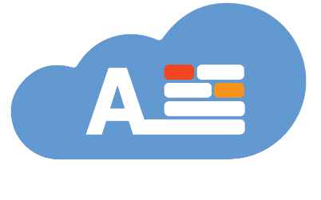
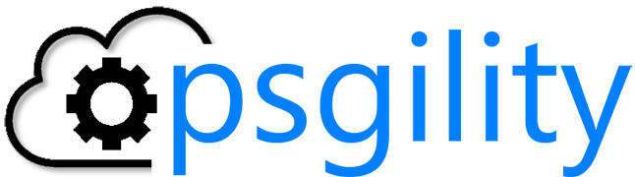
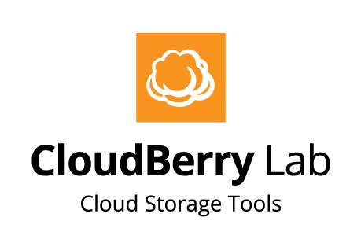

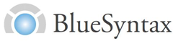



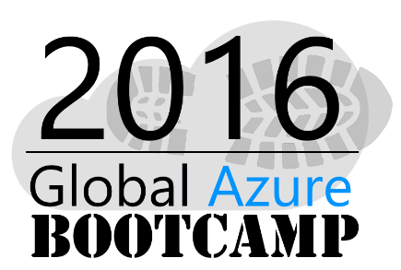
2015 Global Sponsors
Make sure to ask the organizers for the “Stuff We All Get” information!
Notes:
HUSK FROKOST SPONSOR!!!
Vision Solutions + Microsoft
Vision Solutions har desuden doneret nogle gadgets – men husk der skal være til alle!

